Slide 1
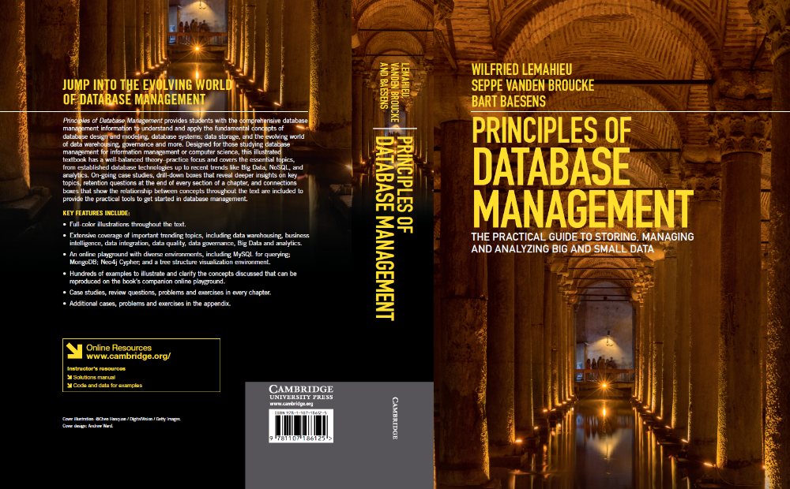
Architecture and Classification of DBMSs
www.pdbmbook.com

Slide 2
Introduction
Architecture of a DBMS
Categorization of DBMSs

Slide 3
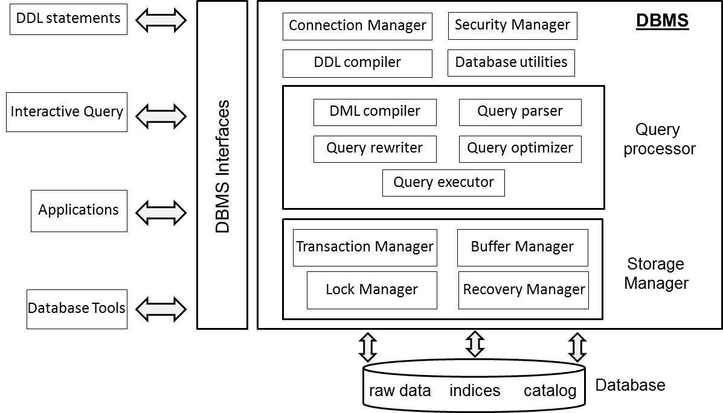
Architecture of a DBMS

Slide 4
Architecture of a DBMS
Connection and Security Manager
DDL Compiler
Query Processor
Storage Manager
DBMS Utilities
DBMS Interfaces

Slide 5
Connection and Security Manager
Connection manager provides facilities to setup a database connection (locally or through a network)
  verifies logon credentials and returns a connection handle
  database connection can either run as single process or as thread within a process
Security manager verifies whether a user has the right privileges
  read versus write access

Slide 6
DDL Compiler
Compiles the data definitions specified in DDL
Ideally 3 DDLs (internal/logical/external data model)
DDL compiler first parses the DDL definitions and checks their syntactical correctness
DDL compiler then translates the data definitions to an internal format and generates errors if required
Upon successful compilation, DDL compiler registers the data definitions in the catalog

Slide 7
Query processor
Query processor assists in the execution of database queries such as retrieval, insertion, update or removal of data
Key components:
  DML compiler
  Query parser
  Query rewriter
  Query optimizer
  Query executor

Slide 8
DML Compiler
DML compiler compiles the DML statements
Procedural DML
  DML explicitly specifies how to navigate in the database
  record-at-a-time DML
  no query processor
Declarative DML
  DML specifies what data should be retrieved or what changes should be made
  set-at-a-time DML
  query processor

Slide 9
DML Compiler
import java.sql.*;
public class JDBCExample1 {
public static void main(String[] args) {
try {
System.out.println("Loading JDBC driver...");
Class.forName("com.mysql.jdbc.Driver");
System.out.println("JDBC driver loaded!");
} catch (ClassNotFoundException e) {
throw new RuntimeException(e);
}
String url = "jdbc:mysql://localhost:3306/employeeschema";
String username = "root";
String password = "mypassword123";
String query = "select E.Name, D.DName" +
"from employee E, department D" +
"where E.DNR=D.DNR;";
Connection connection = null;
Statement stmt=null;
try {
System.out.println("Connecting to database");
connection = DriverManager.getConnection(url, username, password);
System.out.println("MySQL Database connected!");
stmt = connection.createStatement();
ResultSet rs = stmt.executeQuery(query);
while (rs.next()) {
System.out.print(rs.getString(1));
System.out.print(" ");
System.out.println(rs.getString(2));
}
stmt.close();
} catch (SQLException e) {
System.out.println(e.toString());
} finally {
System.out.println("Closing the connection.");
if (connection != null) {
try {
connection.close();
} catch (SQLException ignore) {}}}}

Slide 10
DML Compiler
Impedance mismatch problem
  mapping between OO (e.g. Java) and relational (e.g. SQL) concepts
Impedance mismatch solutions
  host language and DBMS with comparable data structures (e.g., Java and OODBMS)
  middleware to map the data structures from the DBMS to the host language and vice versa

Slide 11
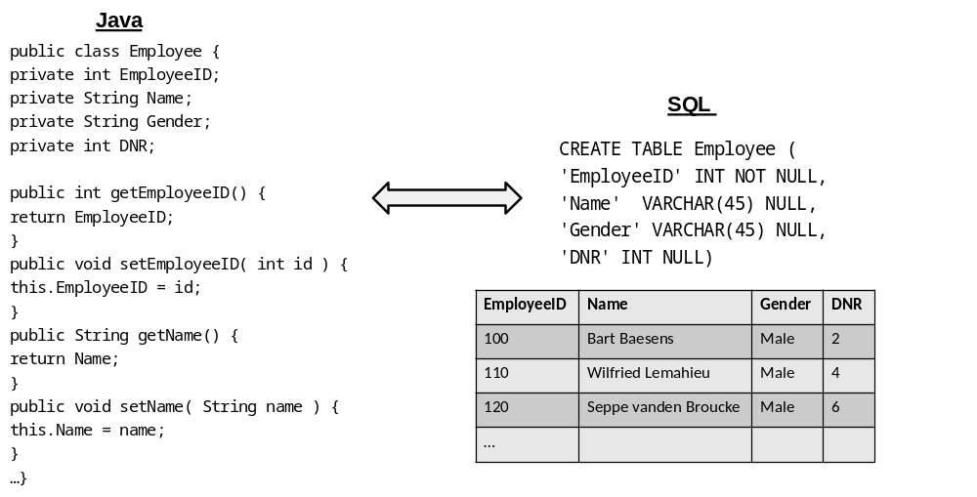
DML Compiler

Slide 12
DML Compiler
DML compiler starts by extracting the DML statements from the host language.
DML compiler then collaborates with the query parser, query rewriter, query optimizer, and query executor for executing the DML statements
Errors are generated and reported if necessary

Slide 13
Query Parser and Query Rewriter
Query parser parses the query into an internal representation format
Query parser checks the query for syntactical and semantical correctness
Query rewriter optimizes the query, independently of the current database state

Slide 14
Query Optimizer
Query optimizer optimizes the query based upon the current database state (based upon e.g. predefined indexes)
Query optimizer comes up with various query execution plans and evaluates their cost in terms of estimated
  number of I/O operations
  CPU processing cost
  execution time
Estimates based on catalog information combined with statistical inference
Query optimizer is a key competitive asset of a DBMS

Slide 15
Query executor
Result of the query optimization is a final execution plan
Query executor takes care of the actual execution by calling on the storage manager to retrieve the data requested

Slide 16
Storage manager
Storage manager governs physical file access and supervises the correct and efficient storage of data
Storage manager consists of
  transaction manager
  buffer manager
  lock manager
  recovery manager

Slide 17
Transaction manager
Transaction manager supervises execution of database transactions
  a database transaction is a sequence of read/write operations considered to be an atomic unit
Transaction manager creates a schedule with interleaved read/write operations
Transaction manager guarantees ACID properties
COMMIT a transaction upon successful execution and ROLLBACK a transaction upon unsuccessful execution

Slide 18
Buffer Manager
Buffer manager manages buffer memory of the DBMS
Buffer manager intelligently caches data in the buffer
Example strategies:
  Data locality: data recently retrieved is likely to be retrieved again
  20/80 law: 80% of the transactions read or write only 20% of the data
Buffer manager needs to adopt smart replacement strategy in case buffer is full
Buffer manager needs to interact with lock manager

Slide 19
Lock Manager
Lock manager provides concurrency control which ensures data integrity at all times
Two types of locks: read and write locks
Lock manager is responsible for assigning, releasing, and recording locks in the catalog
Lock manager makes use of a locking protocol which describes the locking rules, and a lock table with the lock information

Slide 20
Recovery Manager
Recovery manager supervises the correct execution of database transactions
Recovery manager keeps track of all database operations in a log file
Recovery manager will be called upon to undo actions of aborted transactions or during crash recovery

Slide 21
DBMS Utilities
Loading utility
Reorganization utility
Performance monitoring utilities
User management utilities
Backup and recovery utility

Slide 22
DBMS Interfaces
Web-based interface
Stand-alone query language interface
Command line interface
Forms-based interface
Graphical user interface
Natural language interface
Admin interface
Network interface
…

Slide 23
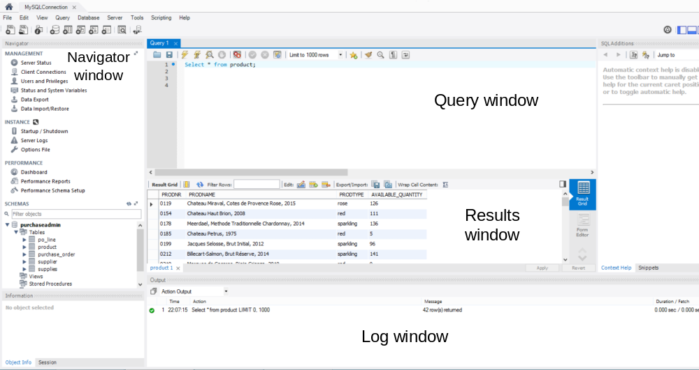
DBMS Interfaces

Slide 24
Categorization of DBMSs
Categorization based on data model
Categorization based on degree of simultaneous access
Categorization based on architecture
Categorization based on usage

Slide 25
Categorization based on data model
Hierarchical DBMSs
  adopt a tree like data model
  DML is procedural and record oriented
  no query processor (logical and internal data model intertwined)
  E.g., IMS (IBM)
Network DBMSs
  use a network data model
  CODASYL DBMSs
  DML is procedural and record oriented
  no query processor (logical and internal data model intertwined)
  CA-IDMS (Computer Associates)

Slide 26
Categorization based on data model
Relational DBMSs
  use the relational data model
  currently the most popular in industry
  SQL (declarative and set oriented)
  query processor
  strict separation between the logical and internal data model
  E.g., MySQL (open source, Oracle), Oracle DBMS (Oracle), DB2 (IBM), Microsoft SQL (Microsoft)

Slide 27
Categorization based on data model
Object-Oriented DBMSs (OODBMS)
  based upon the OO data model
  No impedance mismatch in combination with OO host language
  E.g., db4o (open source, Versant), Caché (Intersystems) GemStone/S (GemTalk Systems)
  only successfull in niche markets, due to their complexity

Slide 28
Categorization based on data model
Object-Relational DBMSs (ORDBMSs)
  also referred to as extended relational DBMSs (ERDBMSs)
  use a relational model extended with OO concepts
  DML is SQL (declarative and set oriented)
  E.g., Oracle DBMS (Oracle), DB2 (IBM), Microsoft SQL (Microsoft)

Slide 29
Categorization based on data model
XML DBMSs
  use the XML data model to store data
  Native XML DBMSs (e.g., BaseX, eXist) map the tree structure of an XML document to a physical storage structure
  XML-enabled DBMSs (e.g., Oracle, IBM DB2) are existing DBMSs that are extended with facilities to store XML data

Slide 30
Categorization based on data model
NoSQL DBMSs
  targeted at storing big and unstructured data
  can be classified into key-value stores, column-oriented databases and graph databases
  focus on scalability and the ability to cope with irregular or highly volatile data structures
  E.g., Apache Hadoop, MongoDB, Neo4j

Slide 31
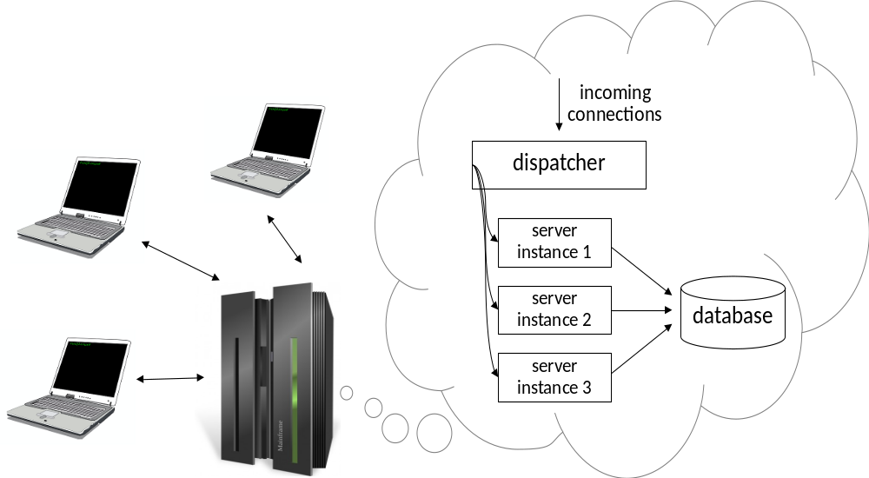
Categorization based upon degree of simultaneous access
Single user versus multi user systems

Slide 32
Categorization based on architecture
Centralized DBMS architecture
  data is maintained on a centralized server
Client server DBMS architecture
  active clients request services from passive servers
  fat server versus fat client variant
n-tier DBMS architecture
  client with GUI functionality, application server with applications, database server with DBMS and database, and web server for web based access

Slide 33
Categorization based on architecture
Cloud DBMS architecture
  DBMS and database are hosted by a third-party cloud provider
  E.g., Apache Cassandra project and Google’s BigTable
Federated DBMS
  provides a uniform interface to multiple underlying data sources
  hides the underlying storage details to facilitate data access

Slide 34
Categorization based on architecture
in-memory DBMS
  stores all data in internal memory instead of slower external storage (e.g., disk)
  often used for real-time purposes
  E.g., HANA (SAP)

Slide 35
Categorization based on usage
On-line transaction processing (OLTP)
  focus on managing operational or transactional data
  database server must be able to process lots of simple transactions per unit of time
  DBMS must have good support for processing a high volume of short, simple queries
On-line analytical processing (OLAP)
  focus on using operational data for tactical or strategical decision making
  limited number of users formulates complex queries
  DBMS should support efficient processing of complex queries which often come in smaller volumes

Slide 36
Categorization based on usage
Big Data & Analytics
  NoSQL databases
  focus on more flexible, or even schema-less, database structures
  store unstructured information such as emails, text documents, Twitter tweets, Facebook posts, etc.
Multimedia
  Multimedia DBMSs provide storage of multimedia data such as text, images, audio, video, 3D games, etc.
  should also provide content-based query facilities

Slide 37
Categorization Based on Usage
Spatial applications
  spatial DBMSs support storage and querying of spatial data (both 2D and 3D)
  Geographical Information Systems (GIS)
Sensoring
  sensor DBMSs manage sensor data such as biometric data from wearables, or telematics data

Slide 38
Categorization based on usage
Mobile
  Mobile DBMSs run on smartphones, tablets or other mobile devices.
  should always be online, have a small footprint and be able to deal with limited processing power, storage and battery life
Open source
  code of open source DBMSs is publicly available and can be extended by anyone
  See www.sourceforge.net
  E.g., MySQL (Oracle)

Slide 39
Conclusions
Architecture of a DBMS
Categorization of DBMSs

Slide 40
More information?
www.pdbmbook.com

